Slide 1
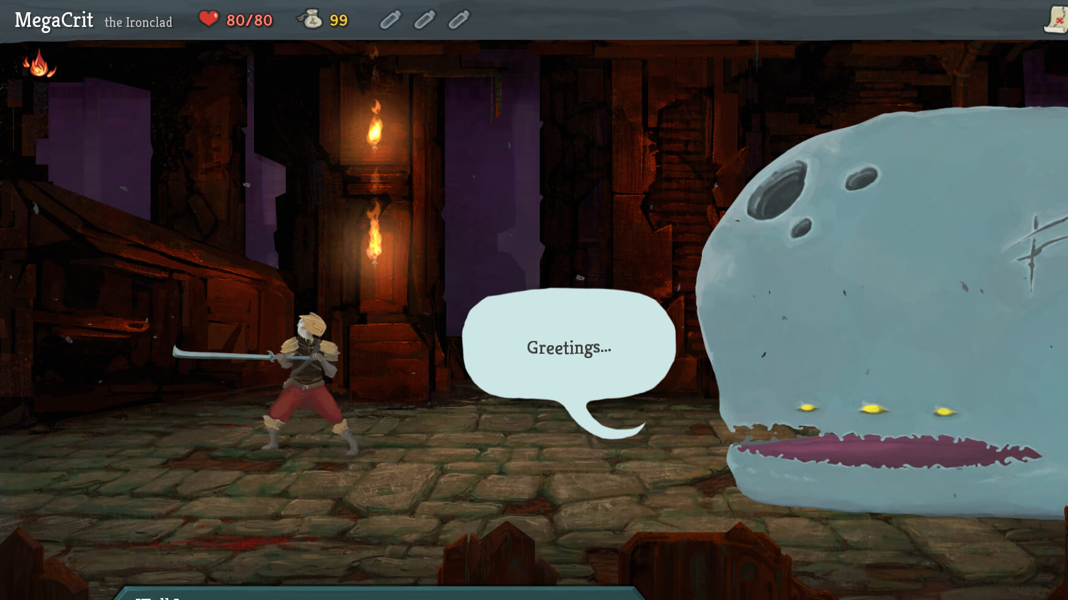
Slay the spire GUI
Jonathan Sarasua

Slide 2
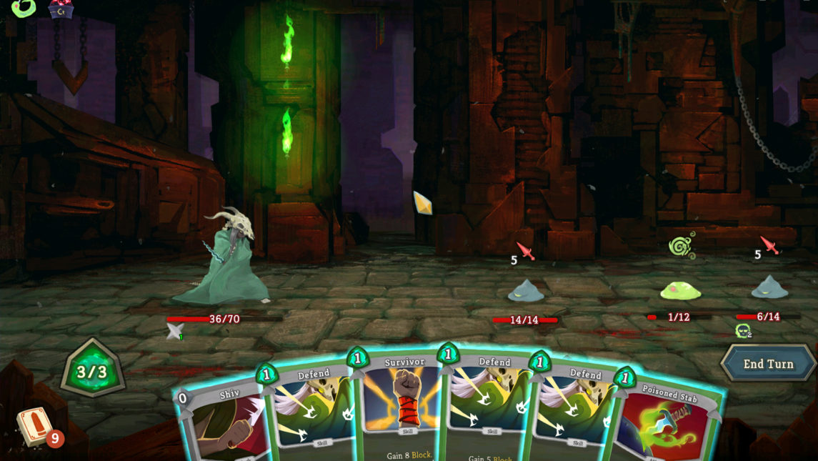
GUI system
Widgets
Widgets
Widgets
Widgets
Transform Hierarchy
States (Visible, Hidden, Pressed, Highlighted, Disabled, etc.)
Properties
Text, Text color, Background color, Image, and more
Cascading defaults
Transition states
XML based
Event System Integration

Slide 3
GUI Testing
Transform Hierarchy
Test positions
States
Test property changes between states
Test states draw/don’t draw
Cascading Defaults
Test properties are set correctly
XML based
Test locations are loaded correctly
Test properties are set
Event System Integration
Test Events are called

Slide 4
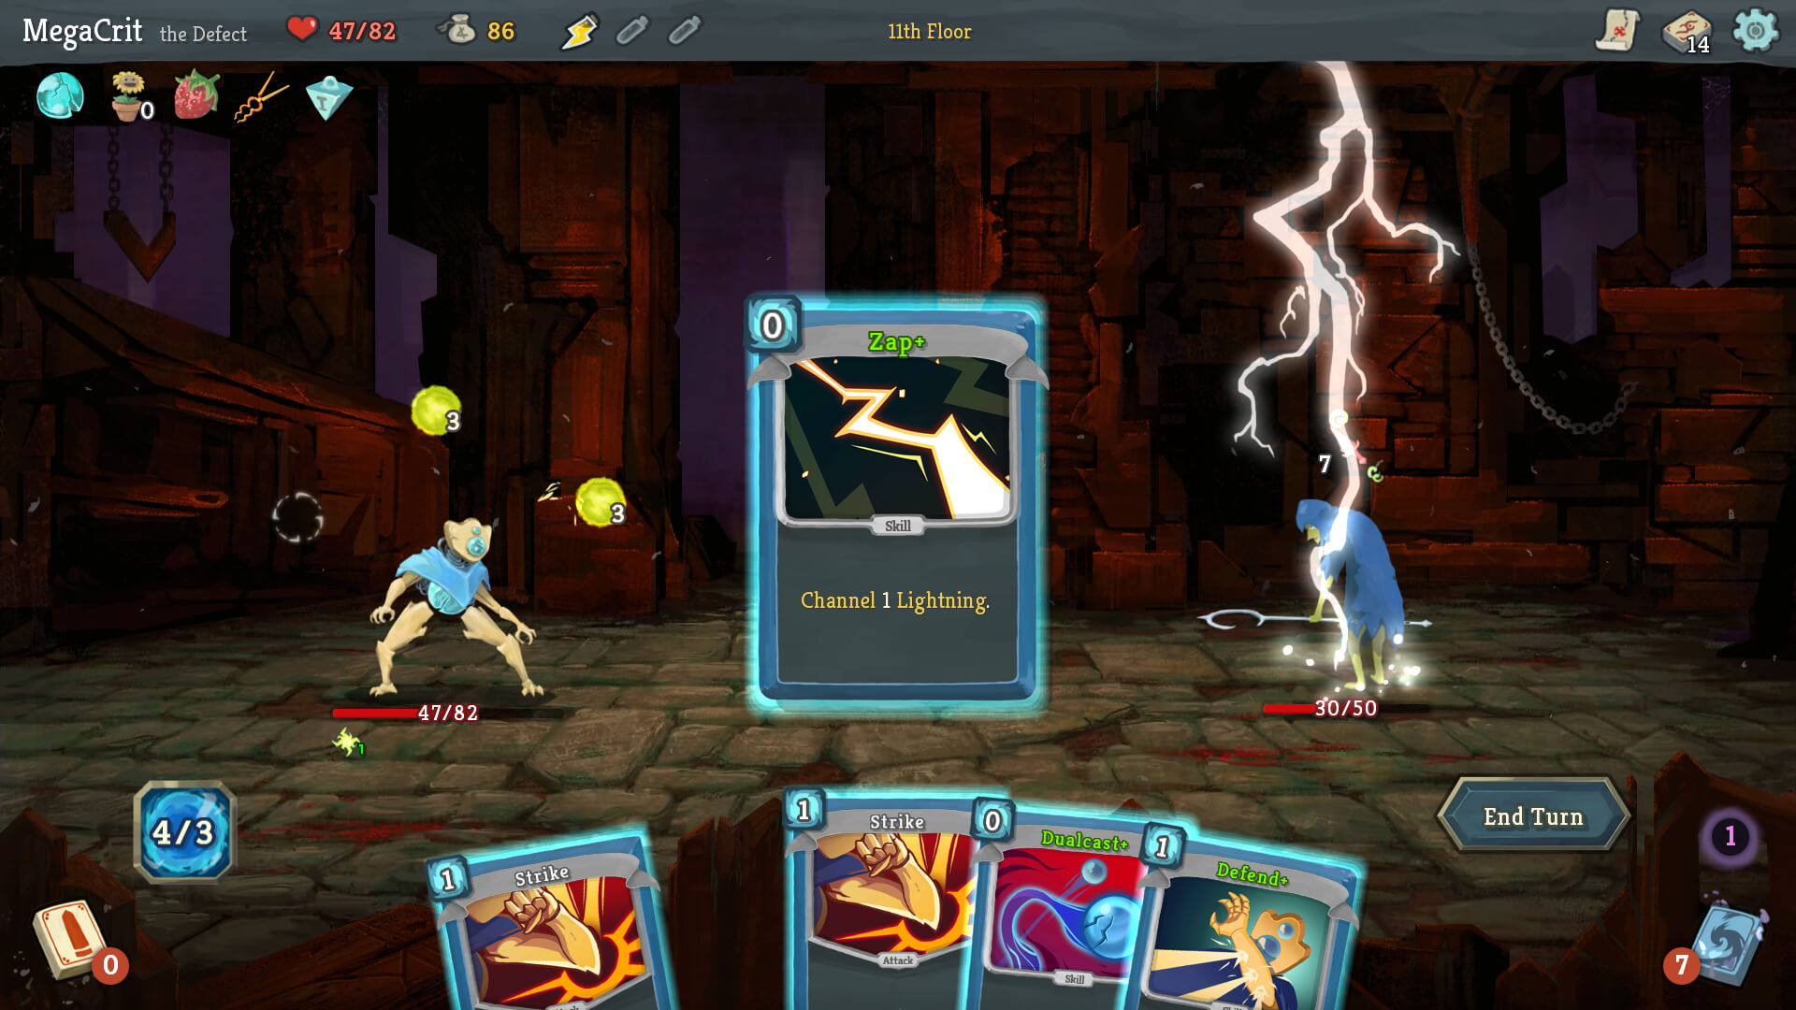
artifact
Mouse controls
Deckbuilding mechanics
Play cards, but have ways of gaining and removing cards
Slay The Spire-like rules and encounters

Slide 5
Artifact Testing
Card game rules
Test drawing, playing, discarding puts cards in the correct locations
Deckbuilding
Test Deck matches after adding, removing, or upgrading cards
Slay The Spire-like rules and encounters
Test health loss works
Test victory condition reached

